Slide 1

SAP BTP ABAP on Cloud / RAP Training
DAY-20
Anubhav Oberoy
www.AnubhavTrainings.com
Follow excellence with sheer passion

Slide 2


DISCLAIMER
The training content and delivery of this presentation is confidential, and cannot be recorded, or copied and distributed to any third party, without the written consent of Anubhav Trainings

Slide 3

01
Attachment
02
Extensibility
03
Embedded Steampunk
04
Scenario
Notes:
https://pixabay.com/photos/san-francisco-transamerica-pyramid-1633203/

Slide 4
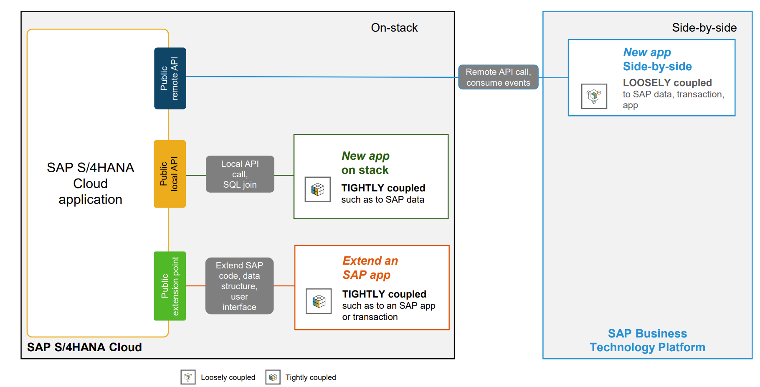
Extensibility Patterns
www.anubhavtrainings.com

Slide 5
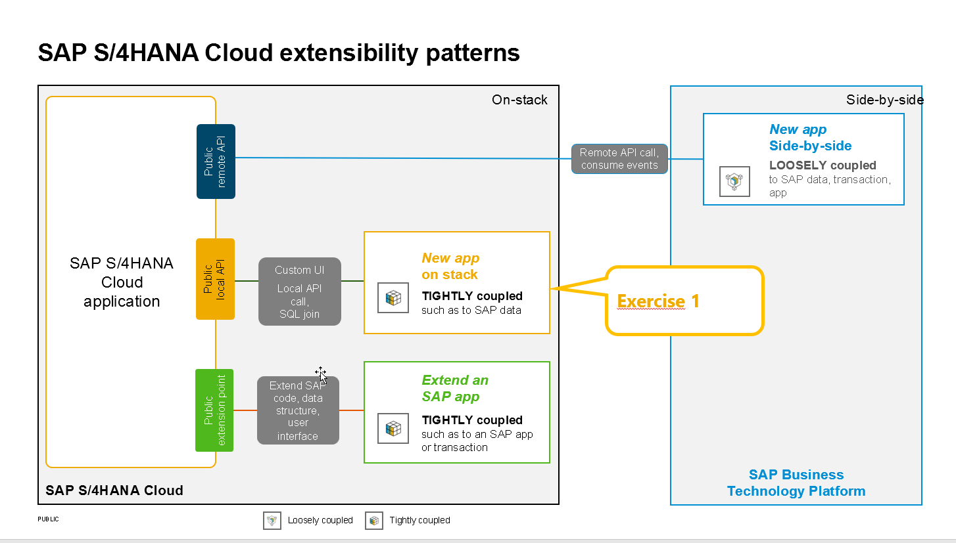
Scenario
The first aspect of developer extensibility is how to use RAP business objects that have been C1-released by SAP or SAP partners for the use in ABAP Cloud development.
In Exercise 1 you will learn how you can leverage the released RAP business object I_BankTP. You will learn how you can use a new wizard in ADT that lets you generate a custom UI on top of a released RAP business object without having to write a single line of code. An additional (optional) task is to call the same released RAP business object from within a class which shows how released RAP business objects can also be used in application jobs.
The second aspect of developer extensibility is the option to extend an extensible RAP business object that has been delivered by SAP or a SAP partner.
In Exercise 2 you will extend the behavior of the base RAP business object that has been generated in the Getting Started section. You will learn how extend the behavior of the base RAP BEO by validations, determinations and side effects.
In Exercise 3 you will then continue to extend the data model with additional fields.
www.anubhavtrainings.com

Slide 6
Scenario – Shop Application
You have an existing Shop application delivered by SAP, you need to extend extra field and business logic to the application which is standard.
https://github.com/SAP-samples/abap-platform-rap630/tree/main/exercises/ex0
www.anubhavtrainings.com

Slide 7

Certification
https://training.sap.com/certification/validity?keepQueryParams=1&keepRequestMethod=1
https://training.sap.com/certification/c_abapd_2309-sap-certified-associate--back-end-developer---abap-cloud-g/?
C_ABAPD_2309
SAP Certified Associate – Back-End Developer - ABAP Cloud
Raj.shettyhyd@gmail.com
DYOR
Anubhav.abap@gmail.com
www.anubhavtrainings.com

Slide 8
www.anubhavtrainings.com
Thank You
End of Day 20
www.anubhavtrainings.com

Slide 9


We’re committed to empower you to be
#FutureReady
through powerful training solutions.
We build the workforce of the future.
250+
Corporate Clients
30,000+
Learners Trained
25000+
Learners Placed
FREE WEBINARS
Sign up for free webinars with industry experts every fortnight!
Enroll Now!
Contact us today!
https://anubhavtrainings.com

